Slide 1
Line Differential

Slide 2
Current Differential Principle
End A
End B
I
F
I
I
A
B
Relay A
Relay B
Communication Link
IA + IB = 0 Healthy
IA + IB ≠ 0 (= IF) Fault

Slide 3
Three Ended Line Protection
I
I
I
A
F
B
I
C
End A
End B
End C
IA + IB + IC = 0 Healthy
IA + IB + IC ≠ 0 (= IF) Fault

Slide 4
MiCOM P54x
All Digital/Numerical Design
End A
End B
0 I I I I I I 0 I 0 . . . . . 0 I 0 I I I I I I 0
Digital messages
Relay A
Relay B
A/D
μP
Digital communication interface

Slide 5
MiCOM P54x
Current Differential Elements
Fully numerical design
Use standard 56 or 64 kbits/s comms channel
Also work with dedicated optical fibre links
Phase discrimination
Capacitive charging current compensation
Two and three ended feeder protection
Continuous propagation delay time measurement and compensation
Additional InterMiCOM and permissive intertrip (PIT) commands transfer
  Includes 8 freely-programmable commands (per channel) and status transfer bits between line ends
Powerful error checking for secure signalling

Slide 6
MiCOM P54x
Differential protection
I
I
A
B
Differential current
│Idiff│ =│I_{A} + I_{B} + I_{C} │
I
C
Percentage bias k2
Trip
Percentage bias k1
No trip
Is1
Is2
Bias Current
│Ibias│ = ½(│I_{A} │ + │ I_{B} │ + │ I_{C} │)

Slide 7
Time Synchronization
Sample alignment

Slide 8
MiCOM P54x
Propagation Delay Problem
Relay A
Relay B
Current at B
Current received from A
Propagation delay

Slide 9
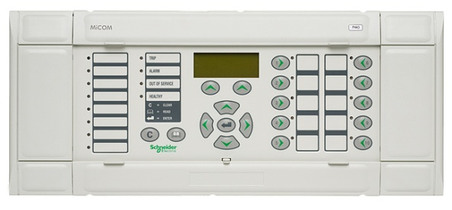
MiCOM P54x
Propagation Delay Time, Measurement - 1
Relay A
Relay B
Data message
Current
vectors
tA1
tA1
tB1
tA2
tp1
tB2
*
tB
tA3
tB3
tA4
tB4
tA5
tB5

Slide 10
MiCOM P54x
Propagation Delay Time, Measurement - 2
Current
vectors
tA1
tA1
tB1
tA2
tp1
tB2
tB*
tA3
td
tB3*
tB3
tA4
tp2
tB4
tA*
Current
vectors
tA5
tB5
tA1
td
tB3
Data message
Propagation delay time tp = tp1 = tp2 = 1/2 (tA* - tA1 – td)
This calculation is sometimes called “ping-pong” method

Slide 11
Communication Error
Compensation

Slide 12
MiCOM P54x
Transient Change in Propagation Delay
Unequal send (tp1) and receive (tp2) delays result in incorrect vector alignment and hence incorrect differential current
Majority of switched communications networks switch send and receive path simultaneously
Some networks may produce transient period where send/receive paths differ
Potential for relay maloperation

Slide 13
MiCOM P54x
Protection for SONET/SDH Systems
With asynchronous sampling, using the “ping-pong” method is necessary to assume:
tp1 = tp2
In order to realign vectors thus allowing phase and magnitude information to be compared at line ends.
BUT: For SONET(Synchronous Optical Network) systems, tp1 can be different than tp2
t₂
t_{d}
t₃
End B
t₁
Current vectors
t_{d}
t₃
Current vectors
t₁
t₁
t_{p1}
t_{p2}
t₄
End A
Notes:
Synchronous Optical Networking (SONET) and Synchronous Digital Hierarchy (SDH) are standardized protocols that transfer multiple digital bit streams synchronously over optical fiber using lasers or highly coherent light from light-emitting diodes (LEDs)
SONET and SDH, which are essentially the same, were originally designed to transport circuit mode communications

Slide 14
MiCOM P54x
SONET/SDH Ring, Configuration
Node
1
Node
2
Node
6
Standby
path
Node
3
t_{p2}’
t_{p1}
Node
5
Node
4
t_{p1}’
t_{p2}
Worker path
Relay A
Relay B
Line
Notes:
The diagram shows a typical Sonnet/SDH ring.
Normally comms messages will be routed by the worker path. If a channel break occurs in the worker path messages will be re-routed by the protection path.
If one channel is routed by the worker path and the other routed by the protection path a differential comms delay will occur. This will normally occur as part of the comms self healing process when a fault is detected. Under certain circumstances this conditions may be present for a long time.
On some comms systems the difference between the worker path and protection path is greater than 1ms. If this condition is present for more than 1/2 cycle the P541/4 may trip the circuit breaker due to measuring a high differential current.

Slide 15
MiCOM P54x
SONET/SDH, Part Routing via Standby Channel
Node
1
Node
2
Node
6
Now, tp2 > tp1
Node
3
t_{p2}’
t_{p1}
Node
5
Node
4
t_{p1}’
t_{p2}
Relay A
Relay B
Line
Notes:
The diagram shows a typical Sonnet/SDH ring.
Normally comms messages will be routed by the worker path. If a channel break occurs in the worker path messages will be re-routed by the protection path.
If one channel is routed by the worker path and the other routed by the protection path a differential comms delay will occur. This will normally occur as part of the comms self healing process when a fault is detected. Under certain circumstances this conditions may be present for a long time.
On some comms systems the difference between the worker path and protection path is greater than 1ms. If this condition is present for more than 1/2 cycle the P541/4 may trip the circuit breaker due to measuring a high differential current.

Slide 16
MiCOM P54x
Transient Change in Propagation Delay (2)
Relay continuously measures the propagation delay
Any change in propagation delay greater than settable value used to raise k1 (initial bias slope) to 200% (effectively blocking relay for currents less than Is2, similar to an overcurrent interlock)
Change is maintained for settable time delay (max. 500ms) to overcome transient period after which k1 is reduced to original value

Slide 17
MiCOM P54x
Transient Change in Propagation Delay (3)
Differential current
│Idiff│ =│I_{A} + I_{B} + I_{C} │
Bias 200%
Percentage bias k2
Percentage bias k1
Is1
Is2
Bias Current
│Ibias│ = ½(│I_{A} │ + │ I_{B} │ + │ I_{C} │)

Slide 18
Current Differential
Communication Link

Slide 19
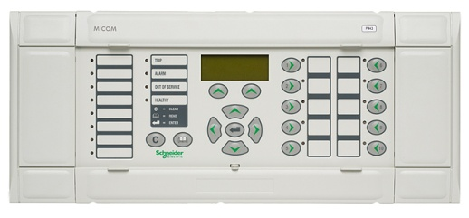
MiCOM P54x
Direct Optical Fibre Link
OPGW

Slide 20
MiCOM P54x / MiCOM P59x
Interfacing to PCM Multiplexers
P591/2
interface
unit
Multiplexer
G.703 or V.35 electrical
850nm multimode
P593
interface
unit
ISDN
X.21 electrical

Slide 21
MiCOM P54x / MiCOM P59x
Multiplexed Optical Link
Earth wire optical fibre
Multiplexer
Multiplexer
34 Mbit/s
Telephone
64k
bits/s
Telecontrol
Teleprotection
End A
End B

Slide 22
MiCOM P54x / MiCOM P59x
Multiplexed Microwave Link
Multiplexer
Multiplexer
Telephone
64k
bits/s
Telecontrol
Teleprotection
End A
End B

Slide 23
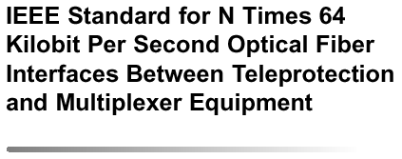
MiCOM P54x
Interfacing Direct Fibre Optic to Multiplexers
IEEE C37.94
Direct connection
no interface!
Multiplexer
850nm multimode

Slide 24
MiCOM P54x
Unique Address Function
To avoids maloperation if multiplexers misdirect data messages
Range of addresses for 2 terminal applications
  1A, 1B; 2A, 2B; _ _ _ _ _ 20A, 20B
Range of addresses for 3 terminal applications
  1A, 1B, 1C; 2A, 2B, 2C; _ _ _ _ _20A, 20B, 20C

Slide 25
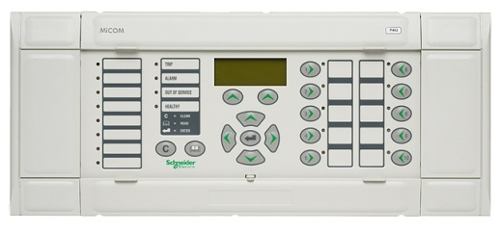
MiCOM P54x
Communications Path for Two Ended Application
Tx
Rx
Rx
CH1
Tx
End A
End B

Slide 26
MiCOM P54x
Redundant Communications
Both channels are active - relays automatically select the correct message should one channel fail
“Hot Standby”
CH1
CH2
End A
End B

Slide 27
MiCOM P54x
Communications Path for Three Ended Application
Rx
CH1
CH2
Tx
Note: Full line protection is provided even should one communications path fail
E.g. For A-B channel fail, C still offers line protection and will intertrip to A and B in the event of a fault
P54x
Tx
End B
Rx
Tx
Rx
Rx
Tx
CH2
CH1
P54x
End C
End A
P54x
CH1
CH2
Tx
Rx
Rx
Tx
Notes:
No InterMiCOM (no pass-through)

Slide 28
MiCOM P54x
Mixed channels for Three Ended Application
Rx
CH1
CH2
Tx
End C has 850nm CH1, and 1300nm CH2
End A has 850nm CH2, and 1300nm CH1
CH1 and CH2 can not be inverted by settings
1300 nm
P54x
1300 nm
Tx
End B
Rx
Tx
Rx
Rx
Tx
CH2
CH1
P54x
End C
End A
P54x
CH1
CH2
Tx
Rx
Rx
Tx
850 nm
Notes:
No InterMiCOM (no pass-through)

Slide 29
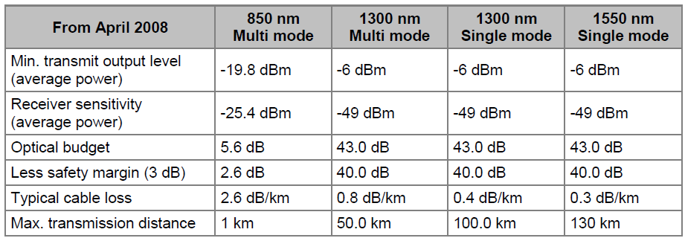
Optical Budgets for Direct Optical
Connection Between Relays
Short Haul
Long Haul
Notes:
.

Slide 30
Make the most of your energy™

